Slide 1
Organization of Public Health in Nevada
Randall Todd, DrPH
Director, Epidemiology & Public Health Preparedness
Washoe County Health District

Slide 2
Five Classifications for Public Health NRS 439
State
District >= 700,000 population
District < 700,000 population
County
City

Slide 3
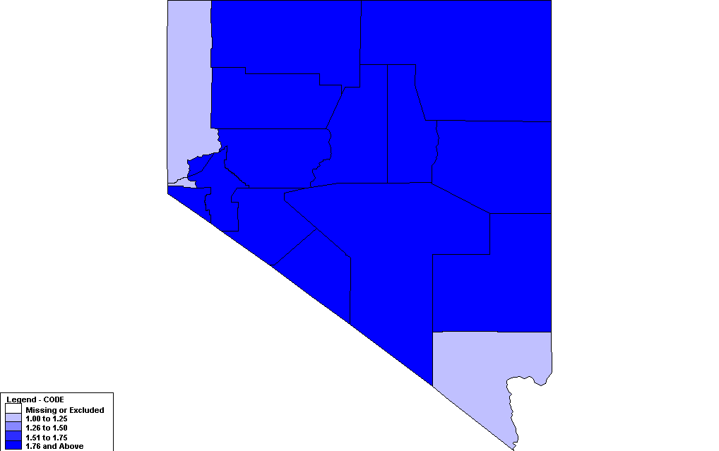
Nevada Counties

Slide 4
Local Public Health
County
Board of Health required
County Commissioners
Sherriff
Health Officer – Chair
County Clerk – Clerk
Health Officer
County Commission required to appoint
Selection criteria
Graduate education in public health
Training
Experience
Interest in public health and related programs
Two year term
Compensation - >= $25/month
May be appointed by Chief Medical Officer (State Health Officer)

Slide 5
Local Public Health
County
Board of Health
Subject to supervision by State Division of Public and Behavioral Health
State Board of Health may require reports
Duties
Oversee all sanitary conditions of the county
Adopt regulations as needed
Prevention, suppression, and control of any contagious or infectious disease dangerous to the public health
Regulations must be approved by State Board of Health

Slide 6
Local Public Health
County
Powers
Abate nuisances in accordance with law
Establish and maintain an isolation hospital or quarantine station when necessary
Restrain, quarantine and disinfect any person or group of persons sick with or exposed to any contagious or infectious disease that is dangerous to the public health
Appoint quarantine officers when necessary and provide medicines, disinfectants and provisions which may be required
Arrange for payment of all debts or charges incurred from any funds available if patient is unable to pay
Adopt fees subject to approval of the County Commission
Fees must be for the sole purpose of defraying costs and expenses of procedures for issuing licenses and permits, and investigations related thereto.

Slide 7
Local Public Health
District < 700,000 population
Creation by affirmative vote
Boards of County Commissioners of 2 or more adjacent counties
Governing bodies of 2 or more cities or towns within a county
Board of County Commissioners and governing bodies of any city(s) or town(s) in such county
Approval of State Board of Health
County or City Boards of Health abolished upon creation of a District Board of Health
District Board of Health
Two members appointed from each jurisdiction making up the District
Additional member chosen by appointees – must be physician
May be appointed by Chief Medical Officer (State Health Officer)

Slide 8
Local Public Health
District < 700,000 population
District Health Officer
Criteria for selection same as County Health Officer
Same authority as County Health Officer
District Health Officer is also a Health Authority
Clinical programs must be physician directed
Compensation fixed by District Board of Health
Services at the pleasure of District Board of Health

Slide 9
Local Public Health
District < 700,000 population
Powers and Duties
Jurisdiction over all public health matters except EMS
Adopt regulations with approval of State Board of Health
Prevent and control nuisances
Regulate sanitation and sanitary practices
Provide for the sanitary protection of water and food supplies
Protect and promote the public health generally

Slide 10
Local Public Health
District >= 700,000 population
Creation by NRS 439.362
District Board of Health
Two representatives of the Board of County Commissioners
Two representatives of the governing body of the largest city
One representative from each of the other cities
Additional representatives chosen by the above
Two physicians – one with experience providing services to minorities and underserved populations
One nurse
One representative with expertise in environmental health
One representative from a non-gaming industry
One representative from the association of gaming establishments

Slide 11
Local Public Health
District >= 700,000 population
Funding
Health District fund required to be established by the County
Used exclusively for the Health District
Amount not to exceed:
3.5 cents on each $100 of assessed valuation of all taxable property in the county
District Health Officer
Licensed to practice medicine or osteopathic medicine or be eligible for such license and obtain such license within 12 months of appointment
Have at least 5 years of management experience in local, state or national public health department, program, organization or agency
Have:
At least a master’s degree in public health, healthcare administration, public administration, business administration or a related field OR
Work experience which is deemed to be equivalent to a degree described above OR
Obtained certification from or be eligible to be certified by the American Board of Preventive Medicine, the American Osteopathic Board of Preventive Medicine

Slide 12
Chief Medical Officer (State Health Officer)
Requirements
Citizen of the United States
At least five years of managerial experience in public or behavioral health
Be:
Licensed or eligible for licensure as a physician or administrative physician in Nevada OR
Licensed or eligible for licensure as a physician or administrative physician in District of Columbia or any state of territory of the United States OR
A physician or administrative physician with a master’s or doctoral degree in public health or a related field

Slide 13
Local Public Health
District >= 700,000 population
Powers and Duties
Same as County Board of Health
District Health Officer is also a Health Authority
Jurisdiction over all public health matters including EMS
Adopt regulations with approval of State Board of Health
Prevent and control nuisances
Regulate sanitation and sanitary practices
Provide for the sanitary protection of water and food supplies
Protect and promote the public health generally
Improve the quality of health care services for members of minority groups and medically underserved populations.

Slide 14
Health Authority NRS 441A
District Healthy Officer or Designee
Chief Medical Officer or Designee

Slide 15
Health Authority NRS 441A
Reportable disease – to Health Authority
Health Authority shall investigate, prevent, suppress, and control communicable disease
Health Authority may:
Enter private property
Order individual to submit to medical exam or test
Order isolation or quarantine
Health Authority has:
Access to medical and laboratory records
Ability to require healthcare providers or medical facilities to pay proportion of costs associated with certain investigations
Ability to petition court for subpoena related to certain investigations
Ability to issue cease and desist orders

Slide 16
Summary
Public Health in Nevada
Three levels
County
District
State
Different requirements and capabilities
Rural jurisdictions have historically been served by the State Health Authority
Public Health Nurses and Environmentalists
Work for state but often live in community
Spread thin
Rural jurisdictions now being asked to pay for state-provided services
Potential catalyst for more local involvement?

