Slide 1
Rethinking Efficiency: Savings, Value, or Both?
Learning Community Quarterly Webinar
November 7, 2014
Use Telephone for Audio Connection: 888-226-0461.
Please mute your Internet speakers by clicking green icon at top of your computer screen
Please place your telephone on mute during the webinar presentation.

Slide 2
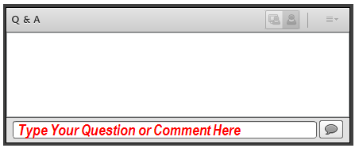
Q&A and Discussion
Type into the Q&A and Discussion box at lower right of your computer screen.

Slide 3
Learning Objectives
Understand what influences and motivates elected officials and other decision-makers as key audiences for education about public health's value.
Understand how focusing on “return on investment” may (and often does) undermine efforts to promote the value of public health.
Understand how shifting focus to “return on objective” may better align with the mission of public health and more effectively persuade decision-makers in public and private sectors.

Slide 4
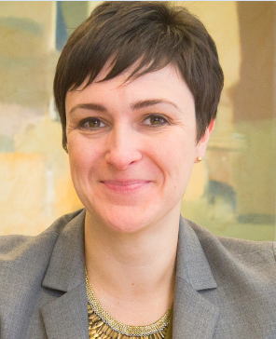
Presenter
Emily J. Holubowich, MPP
Senior Vice President, CRD Associates Executive Director, Coalition for Health Funding
@healthfunding

Slide 5
ROI: Right for Public Health?
What influences lawmakers and other policymakers?
Does ROI actually undermine efforts to promote public health?
Are there better ways to communicate value?

Slide 6
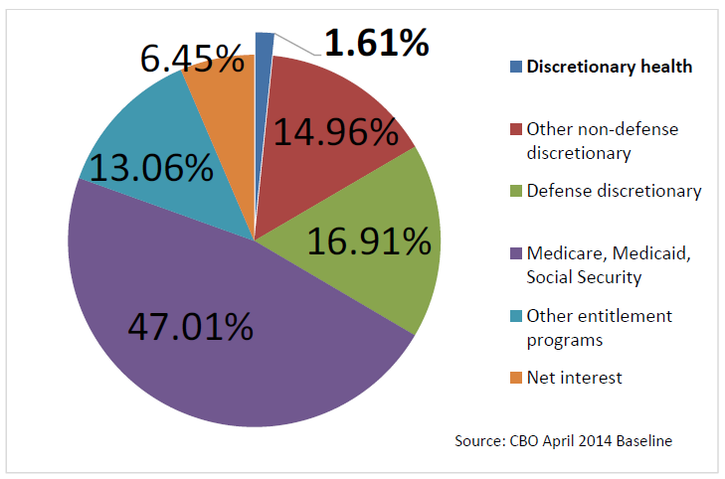
Federal Spending, FY 2014

Slide 7
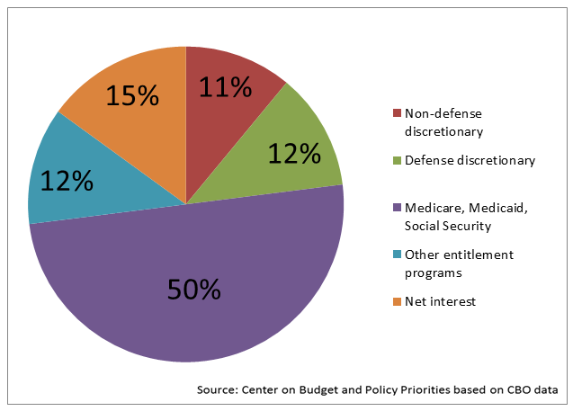
Federal Spending, FY 2022

Slide 8
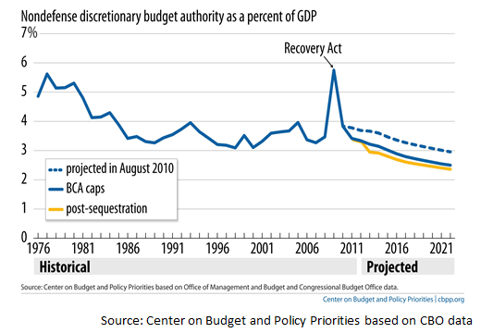
NDD Lowest Level Since 1962

Slide 10
The Lost Decade
Levels are too low
Zero sum gain going forward
“Robbing Peter to pay Paul”
Fierce competition for limited resources
Must do vs. nice to do
Research vs. public health
“Hard science” (i.e., basic and clinical) vs. “soft science” (i.e., population-based research, health services research)
Infectious disease control vs. chronic disease prevention

Slide 11
Cannibalization of Health
The core of public health used to be society’s interest in securing the conditions necessary for human survival—mainly meaning epidemiology and combating communicable diseases. The pity is that all too often the current CDC has diluted its mission and budget by funding political causes that the doctors and troops in West Africa (and Texas) don’t need. The list extends to anti-bullying, trans fats, prescription opiate abuse, college rape prevention, workplace wellness, “racial and ethnic approaches to community health,” and promoting breast feeding.
—Wall Street Journal, October 9, 2014

Slide 12
Cannibalization of Health (cont)
In recent years, the CDC has received significant amounts of funding. Unfortunately, however, many of those funds have been diverted away from programs that can fight infectious diseases, and toward programs far afield from the CDC’s original purpose…
While protecting Americans from infectious diseases received only $180 million from the Prevention Fund, the community transformation grant program received nearly three times as much money—$517.3 million over the same five-year period. —Gov. Bobby Jindal (R-LA), Politico Magazine, October 12, 2014

Slide 13
With Challenges, Come Opportunities
Lawmakers forced to make tough choices
What works in public health?
Simply doing what’s “right” isn’t enough
Emphasis on evidence, impact
Community has opportunity to EDUCATE:
Explain what you do, and why its important
Share evidence to inform policy decisions

Slide 14
Know Your Audience
Lawmakers at all levels of government, regardless of party:
Want to make a difference
Put constituents first
Drink from a firehose
Don’t know what they don’t know

Slide 15
Know Your Audience (cont)
Politics often trumps policy
Ideology, moral beliefs drive decision-making
Conservatives committed to principle, limited role of government
Liberals committed to policy, expanded role of government

Slide 16
Find Common Ground
Put yourself in their shoes
What words, concepts and themes resonate?
Beware the “backfire effect”
Secure the psyche
Don’t directly challenge identity
Ask what they know

Slide 17
Trouble with ROI
Economists: ROI isn’t appropriate measure for public health
Savings are often not “in time”
Projections are meaningless
Estimates are often in aggregate
Lawmakers can’t relate
Other programs aren’t held to same standard

Slide 18
“Return on Objective” as Alternative
Mission of public health is to improve health, not save money
ROO shows the program accomplished goals that are
Set before implementation
Measurable and attainable
Qualitative or quantitative
Emphasis on health outcomes
Efficiency flows from effectiveness

Slide 19
ROO Resonates More Than ROI
Demonstrates impact in community now (not 20 years from now)
Results don’t necessarily have to be population based
Power in one
Data make you credible, stories make you memorable
See www.cutshurt.org for examples
Shows lawmakers, taxpayers they are “smart purchasers” of goods

Slide 20
Don’t Overthink It
Lawmakers aren’t peer reviewers
Take credit for success
Anecdotes matter
Don’t just tell, show
ROO is “and” not “or”
Show ROI when possible
ROO provides context

Slide 21
Contact
Emily J. Holubowich, MPP
Senior Vice President
Cavarocchi ∙ Ruscio ∙ Dennis Associates
202.484.1100
eholubowich@dc-crd.com
Follow Me! @healthfunding

Slide 22
Q&A and Discussion
Type into the Q&A and Discussion box at lower right of your computer screen.

Slide 23
Webinar Evaluation
Please take a few minutes to complete a short evaluation of this webinar by clinking November 7, 2014 Webinar Evaluation or pasting the following URL into your web browser: https://survey.qualtrics.com/SE/?SID=SV_e5TeYZJHZHECYvz

